Slide 1
The Linked Open Data Editor for BIBFRAME in Alma
Yoel Kortick
Yoel.Kortick@clarivate.com

Slide 2
Introduction to this presentation
Editing an existing BIBFRAME record
Creating a new BIBFRAME record
Creating a new BIBFRAME record from a template
Creating a new BIBFRAME record from blank
Adding a field or section to a BIBFRAME record
Adding a field to a BIBFRAME record - two live examples
Adding a section to a BIBFRAME record - two live examples
Using the "Lookup" to enter a value in the field
Not using the "Lookup" to enter a value in the field
Obtaining information (help) about a specific field
Agenda

Slide 3
Introduction

Slide 4
Introduction
See also: A Flexible Approach to BIBFRAME Cataloging with the Linked Open Data Editor Now Available in Alma
The Linked Open Data (LOD) in Alma editor provides catalogers with a simple, flexible, and ontology-driven way to edit metadata.
When we state there “ontology-driven” we mean, in the context of Alma's Linked Open Data (LOD) editor, that
the editor uses the rules and structure defined in the BIBFRAME and BFLC ontologies to guide how catalogers create and edit records.
the editor uses the BIBFRAME ontology as its rulebook, automatically steering catalogers toward valid, standards-compliant choices rather than leaving them to figure it out manually.
It integrates the capabilities of Linked Data directly into everyday cataloging workflows without adding unnecessary complexity.

Slide 5
Introduction
In addition to this presentation, it is recommended to also see the following on the Ex Libris Knowledge Center:
- Parent / Index Page Navigating the New Linked Open Data Editor for BIBFRAME
Background Information on the BIBFRAME Ontology Structure
How Alma Uses the BIBFRAME and BFLC Ontologies to Create Records
The New LOD Editor: High-Level Explanation and Workflows
Creating and Editing BIBFRAME Records and Templates
Field Configurations
Alma Lookup Service

Slide 6
Introduction
Disclaimer:
BIBFRAME in Alma is currently undergoing a major development phase. Consequently, screenshots and statements in this presentation are subject to change.
In order for the BIBFRAME functionality to be used, BIBFRAME must be enabled in your institution. See Enabling BIBFRAME in Your Institution

Slide 7
Editing an existing BIBFRAME record

Slide 8
Editing an existing BIBFRAME record
To edit an existing BIBFRAME record, the record may first be retrieved and then the cataloger can click “edit”.
This is the case for both BIBFRAME Works as well as BIBFRAME Instances.
After clicking “edit” the Linked Open Data Editor for BIBFRAME will open and the record will be in Draft mode until either saved or released.
Alma “knows”
If the record is of type BIBFRAME to automatically open the Linked Open Data Editor for BIBFRAME
If the record is not of type BIBFRAME to open the previously-existing metadata editor
As previously shown:
Works are retrieved via the Works Search.
Instances are retrieved via the All Titles search.

Slide 9
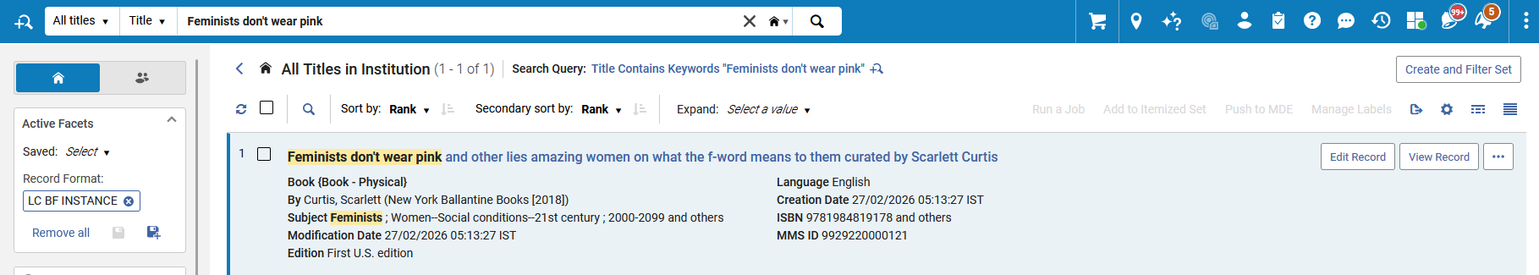
Editing an existing BIBFRAME record
Here we have retrieved a BIBFRAME Instance via an All Titles search and we will click “Edit record”

Slide 10
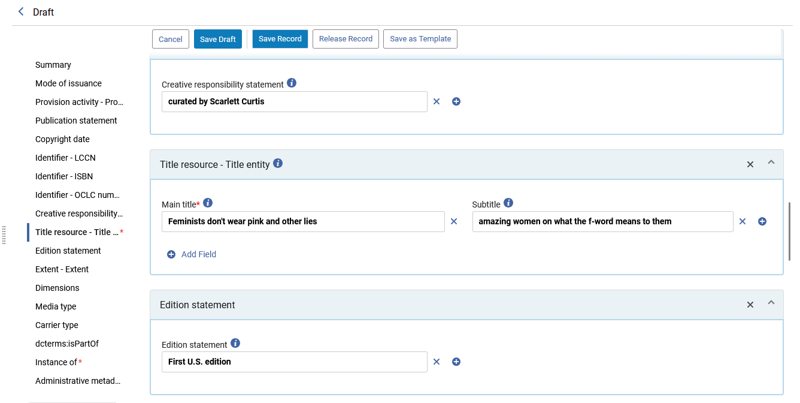
Editing an existing BIBFRAME record
The instance opens in draft mode in the Linked Open Data Editor for BIBFRAME:

Slide 11
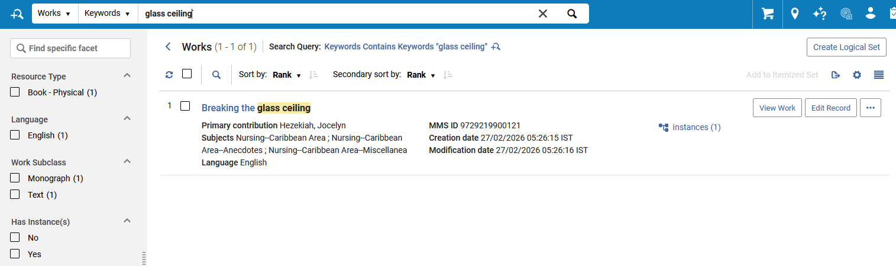
Editing an existing BIBFRAME record
Here we have retrieved a BIBFRAME Work via a Works search and we will click “Edit record”

Slide 12
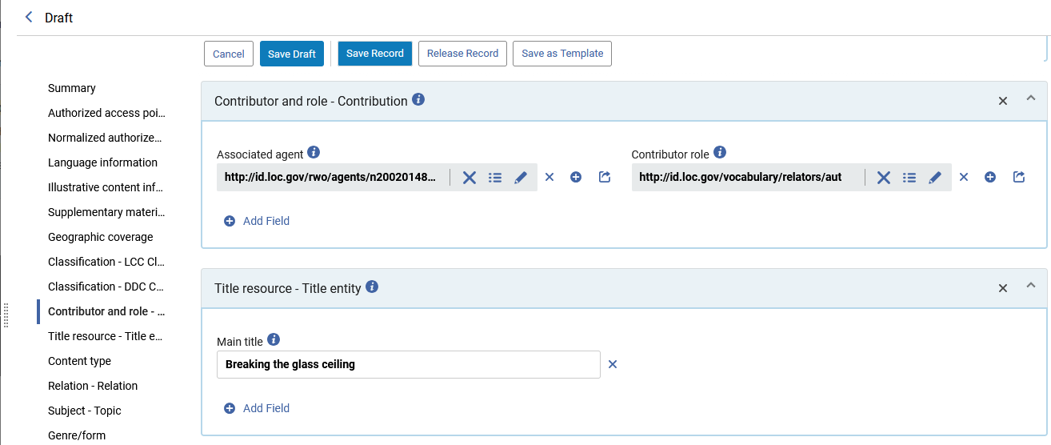
Editing an existing BIBFRAME record
The work opens in draft mode in the Linked Open Data Editor for BIBFRAME:

Slide 13
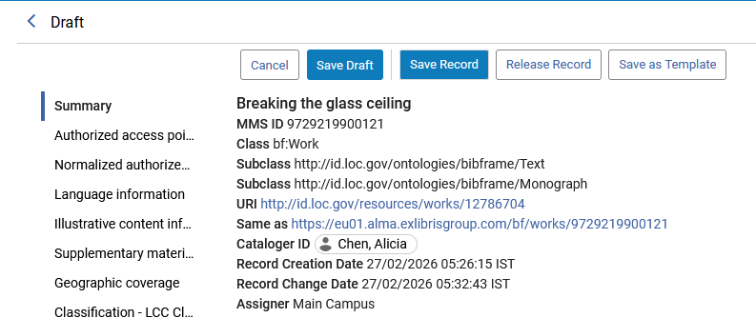
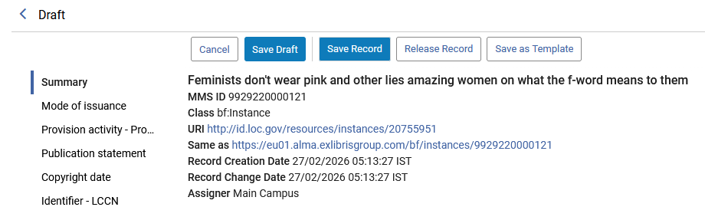
Editing an existing BIBFRAME record
Unless “Save record” or “Release Record” is clicked, the record will remain in edit mode.
In this example we have not clicked “Save record” or “Release Record”

Slide 14
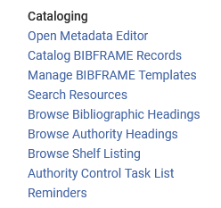
Editing an existing BIBFRAME record
The BIBFRAME records we edited are now in edit mode and can be accessed at “Resources > Cataloging > Catalog BIBFRAME Records”

Slide 15
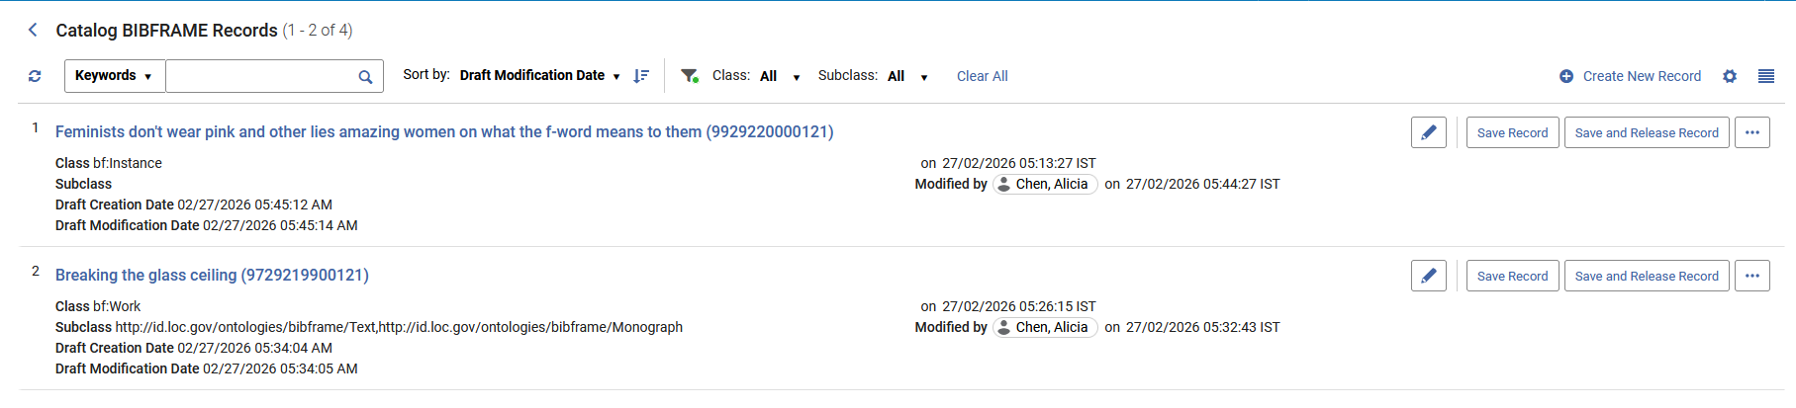
Editing an existing BIBFRAME record
Both records appear:

Slide 16
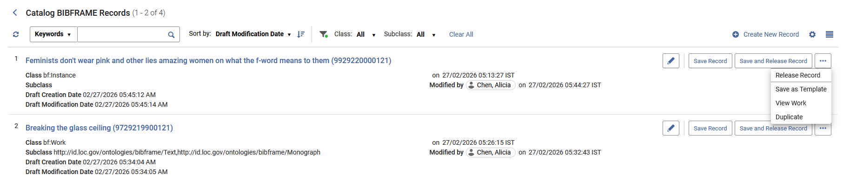
Editing an existing BIBFRAME record
The records may be released by selecting either “Save and Release Record” or “Release Record”

Slide 17
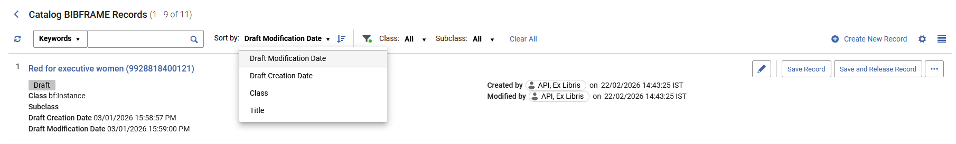
Editing an existing BIBFRAME record
The records which appear in the “Catalog BIBFRAME records” page can be sorted ascending and descending by a variety of methods

Slide 18
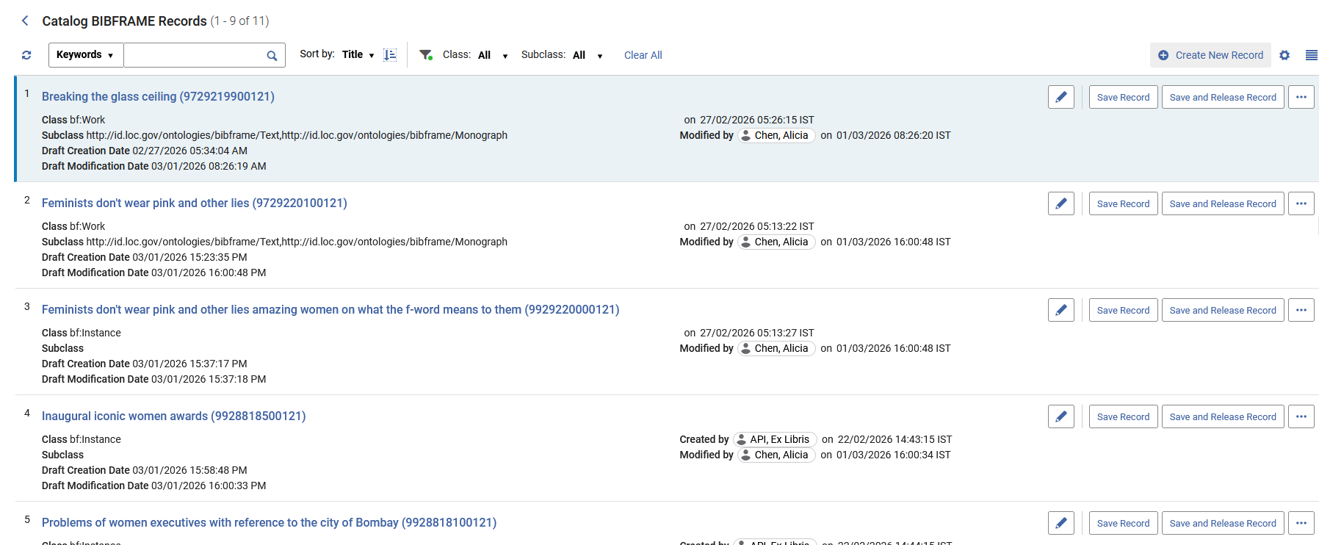
Editing an existing BIBFRAME record
Here the records are sorted ascending by title

Slide 19
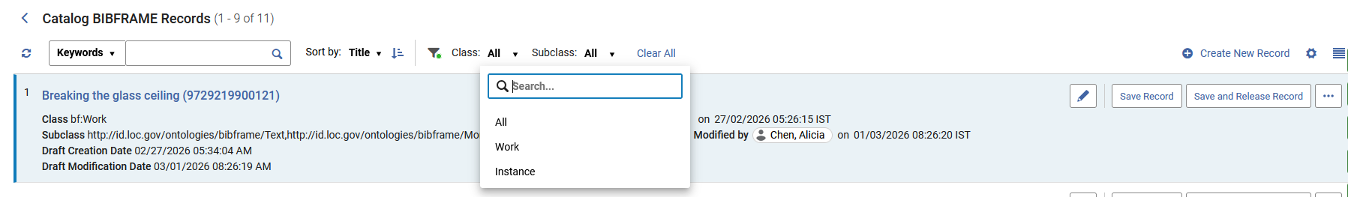
Editing an existing BIBFRAME record
The records which appear in the “Catalog BIBFRAME records” page can be filtered by class and subclass
Here we can filter by Class

Slide 20
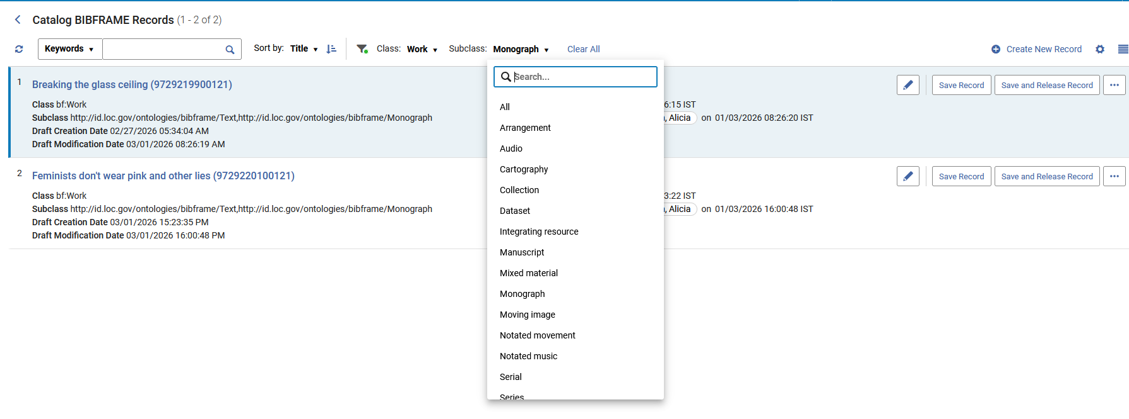
Editing an existing BIBFRAME record
The records which appear in the “Catalog BIBFRAME records” page can be filtered by class and subclass
Here we can filter by Subclass

Slide 21
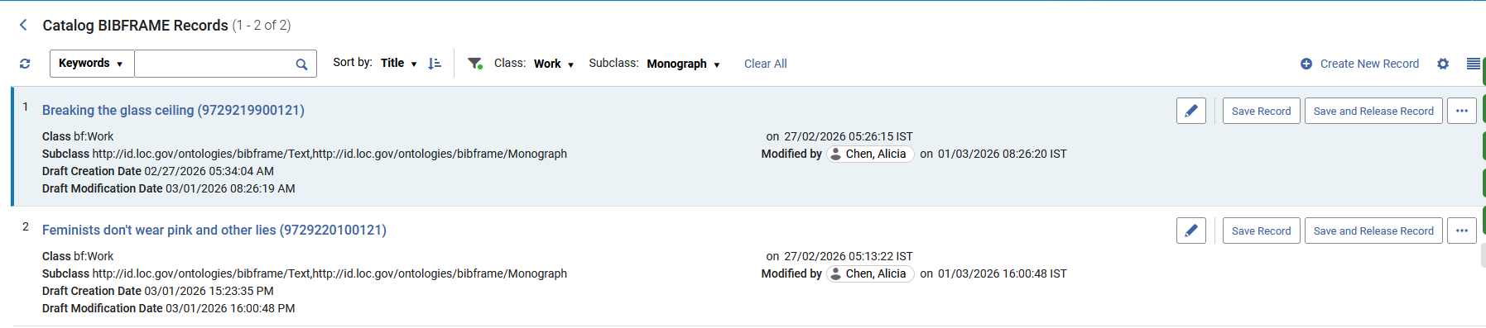
Editing an existing BIBFRAME record
Here we have filtered by
Class = Work
Subclass = Monograph

Slide 22
Creating a new BIBFRAME record

Slide 23
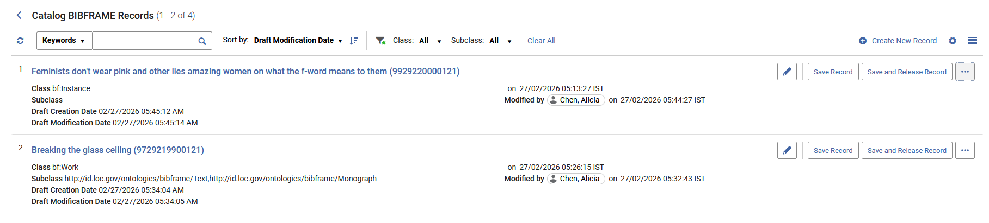
Creating a new BIBFRAME record
To create a new Work or an Instance:
Select ”Resources > Cataloging > Catalog BIBFRAME Records”.
Select ”Create New Record”.

Slide 24
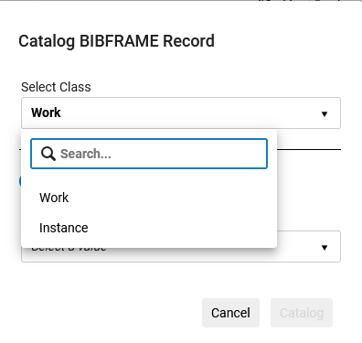
Creating a new BIBFRAME record
Select the desired Class (Work or Instance).

Slide 25
Creating a new BIBFRAME record
Select whether to create the record from a Template or from a Blank form.
“Create from Template”
generates a list of templates relevant to the selected class
Note that the subclass is already set in the template structure
Selecting “Catalog” (which becomes active after choosing a template) opens the cataloging template form.
“Create Blank”
generates a list of subclasses to select.
Selecting Catalog (which becomes active after choosing a subclass) opens the cataloging form.

Slide 26
Creating a new BIBFRAME record from a template

Slide 27
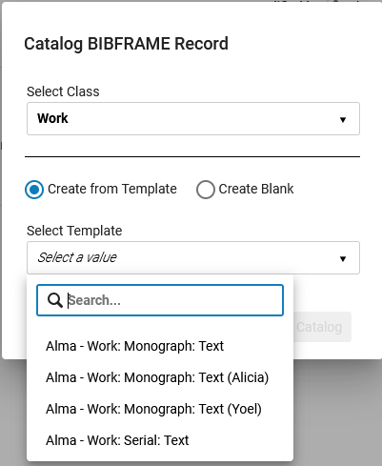
Creating a new BIBFRAME record from a template
Because class “Work” was chosen, we see templates for class “Work”
Here we have selected Class “Work” and “Create from template”
Here we see templates for class “Work” because that is what was chosen above.

Slide 28
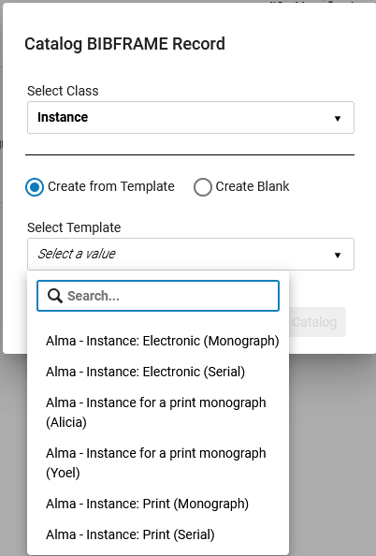
Creating a new BIBFRAME record from a template
Here, because class “Instance” was chosen, we see templates for class “Instance”
Here we have selected Class “Instance” and “Create from template”
Here we see templates for class “Instance” because that is what was chosen above.

Slide 29
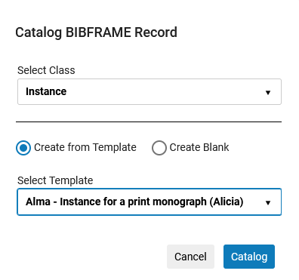
Creating a new BIBFRAME record from a template
After selecting both a class and a template the “Catalog” button becomes active

Slide 30
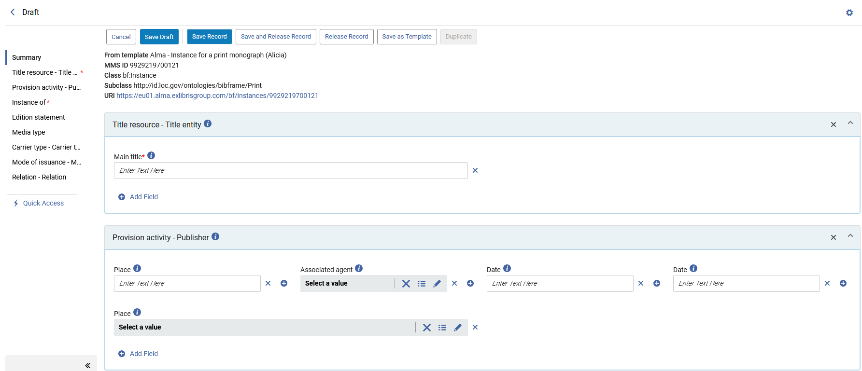
Creating a new BIBFRAME record from a template
Clicking “Catalog” will open a new record (a Work” or an “Instance” depending on the class chosen) in Draft status using the fields and values of the fields from the template

Slide 31
Creating a new BIBFRAME record from blank

Slide 32
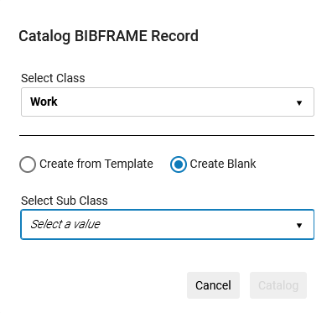
Creating a new BIBFRAME record from blank
It is also possible to create a new BIBFRAME record (Work or Instance) from scratch.
Selecting “Create Blank” generates a list of subclasses to select.
Selecting Catalog (which becomes active after choosing a subclass) opens the cataloging form.
We selected Class “Work” and then “Create Blank”
Now we will click here to select a Sub Class
The “Catalog” button is not yet active because a Sub Class has not yet been chosen.

Slide 33
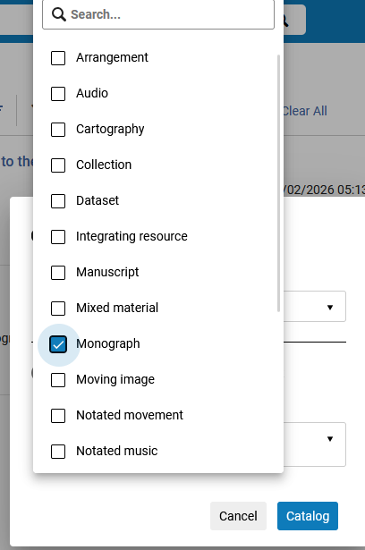
Creating a new BIBFRAME record from blank
We will select Sub Class “Monograph” (multiple Sub Classes may be chosen)

Slide 34
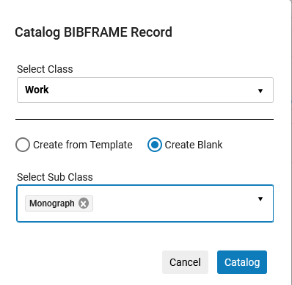
Creating a new BIBFRAME record from blank
Now we can click “Catalog”

Slide 35
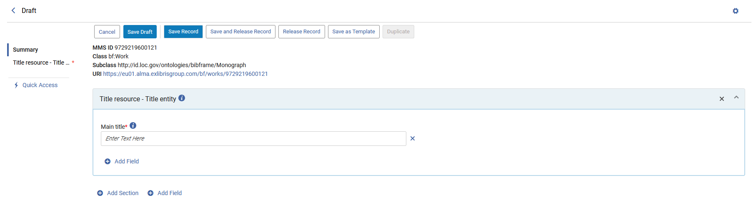
Creating a new BIBFRAME record from blank
A new draft record opens for the select Class and Sub Class(es)
We did not choose to create the record via a template and therefore we have only the field “Title” and will need to manually add additional fields and sections.

Slide 36
Adding a field or section to a BIBFRAME record

Slide 37
Adding a field or section to a BIBFRAME record
The cataloging draft for a BIBFRAME record consists of fields and sections.
Sometimes fields exist and are added “on their own” (not as part of a section).
Other times fields are added as part of a section.

Slide 38
Adding a field or section to a BIBFRAME record
Fields added on their own:
These are fields which can stand alone because they do not depend on and are not related to other fields
These fields can be added on their own without a section.
For example:
“Language information” may be added as a field because it does not depend on other fields
“Illustrative content information” may be added as fields because it does not depend on other fields
“Identifier – LCCN” may be added as a field because it does not depend on other fields

Slide 39
Adding a field or section to a BIBFRAME record
Fields added as part of a section:
These are fields which depend on other fields
These fields are part of a section together with other dependent fields
For example:
“Classification number”, “Classification item number”, “Assigner” and “Status” might be added to a section called “Classification - LCC Classification” because they depend on each other
“Classification number” and “Classification scheme edition” might be added to a section called “Classification - DDC Classification” because they depend on each other
“Associated agent” and “Contributor role” might be added to a section called “Contributor and role - Contribution” because they depend on each other

Slide 40
Adding a field or section to a BIBFRAME record
While editing a record it is possible to
Add a new field to an existing section
by clicking “Add Field” at the bottom of the existing section
Add a new field to the record
by clicking “Add Field” at the bottom of the cataloging draft
Add a new section to the record
by clicking “Add Section” at the bottom of the cataloging draft

Slide 41
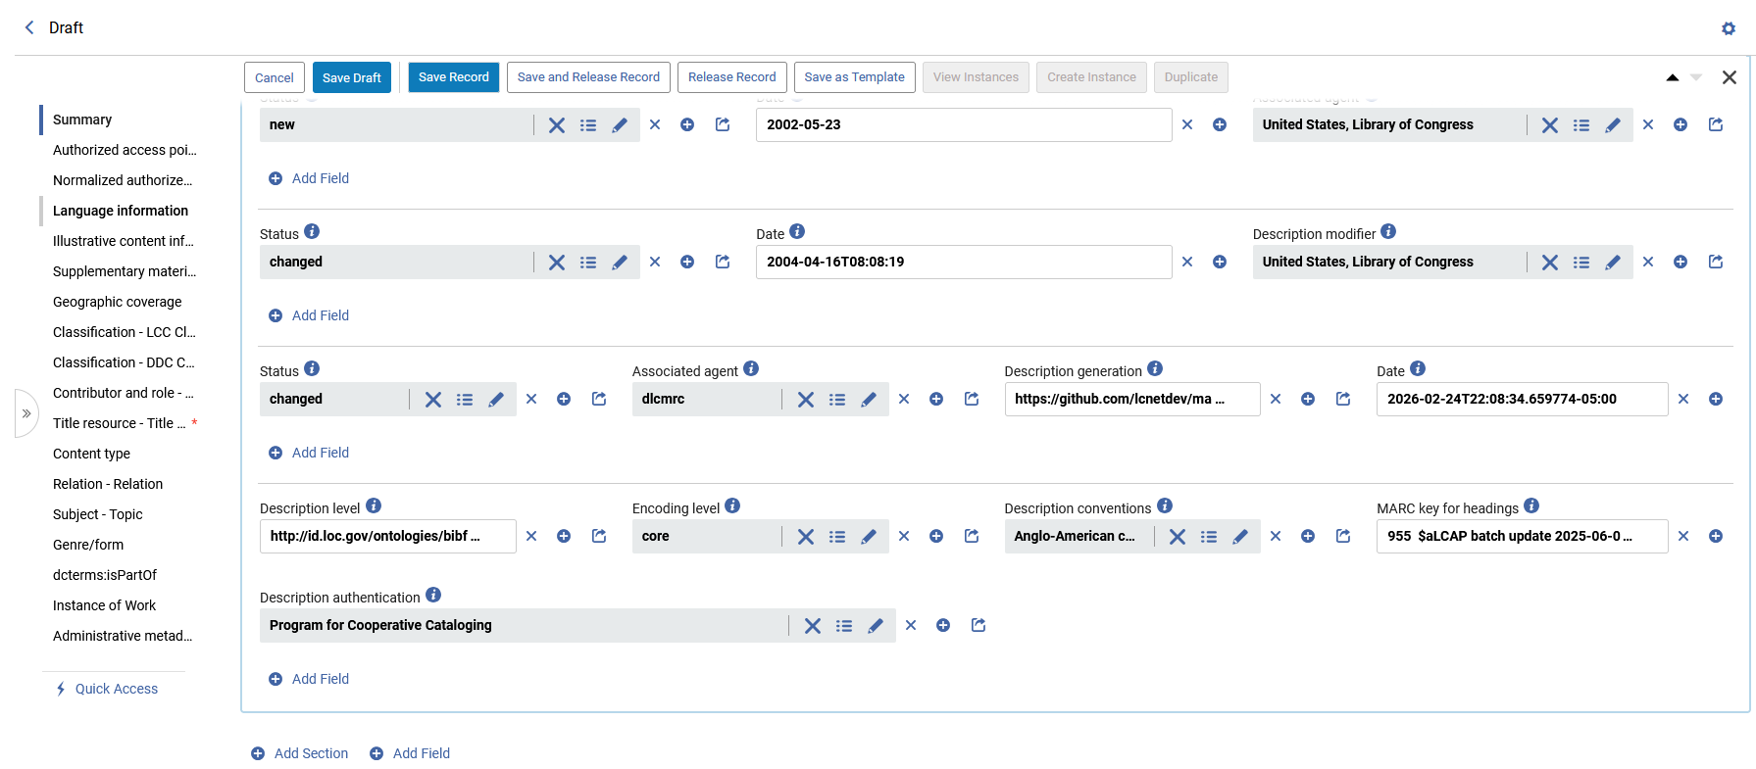
Adding a field or section to a BIBFRAME record
These buttons are parts of specific sections and will add a field to an existing section
These buttons will add a new field or a new section to the draft record

Slide 42
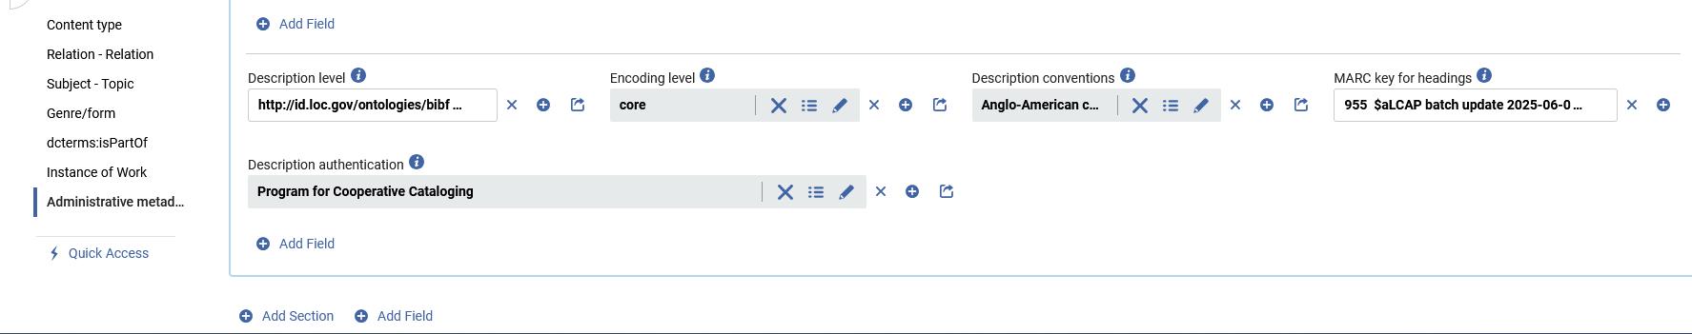
Adding a field or section to a BIBFRAME record
Here is a close-up of where the cataloger can click either “Add Field” or “Add Section”
These buttons are parts of specific sections and will add a field to an existing section
These buttons will add a new field or a new section to the draft record

Slide 43
Adding a field to a BIBFRAME record - two live examples

Slide 44
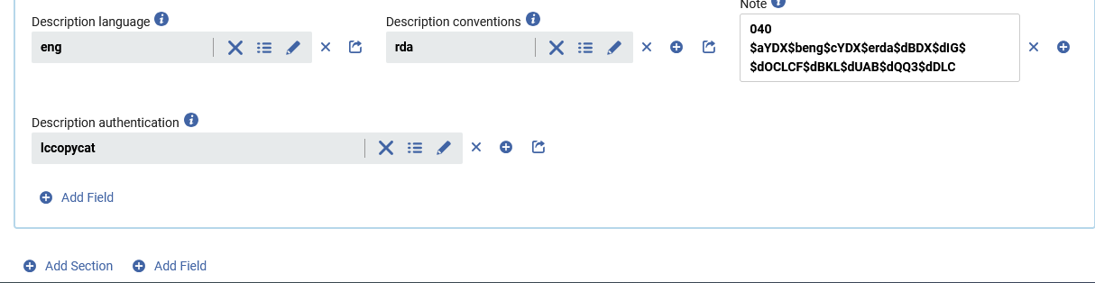
Adding a field to a BIBFRAME record - two live examples
The cataloger will now add field “Identifier – LCCN” (with value “2018377395”) to BIBFRAME Instance title “Feminists don't wear pink and other lies”.
This field will be added “on its own”.
The cataloger will scroll to the bottom of the editing draft and click “Add Field”
Add a field
Example one

Slide 45
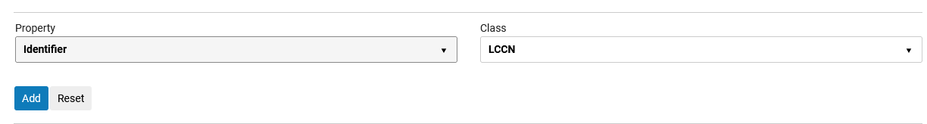
Adding a field to a BIBFRAME record - two live examples
After clicking “Add Field” the cataloger will
Choose the relevant Property (which in this case is “Identifier”)
If relevant choose the relevant Class (which in this case is “LCCN”)
Click “Add”
Add a field
Example one

Slide 46
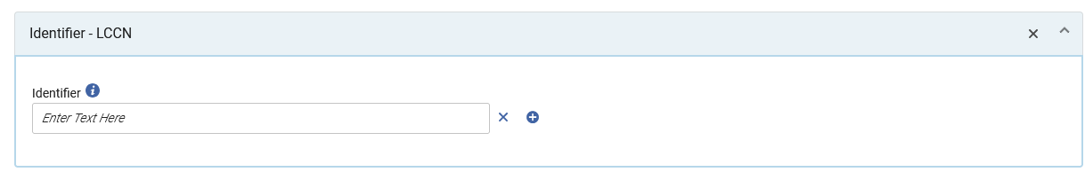
Adding a field to a BIBFRAME record - two live examples
The field is added with a blank value
Add a field
Example one

Slide 47
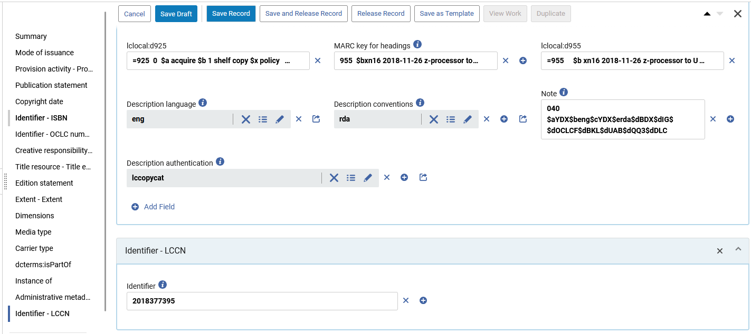
Adding a field to a BIBFRAME record - two live examples
The cataloger adds a value to the field and saves the record or draft
Add a field
Example one

Slide 48
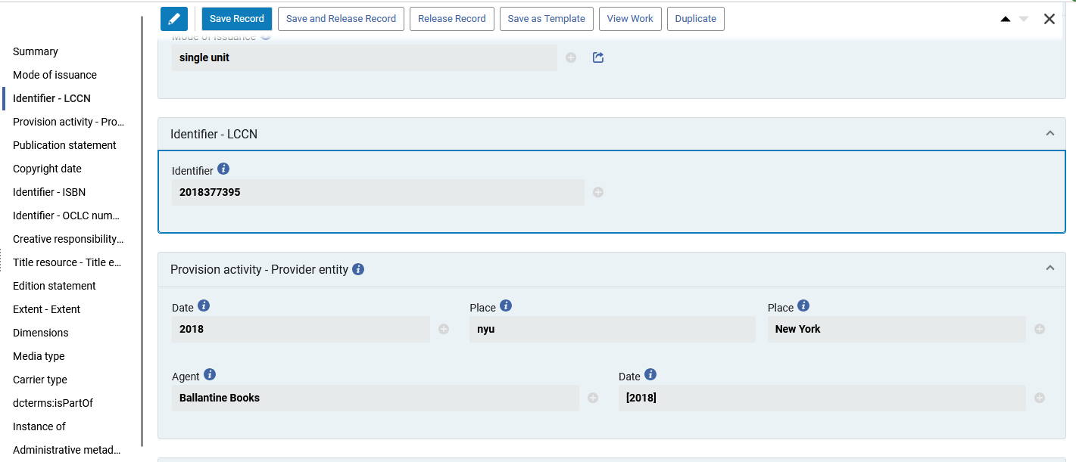
Adding a field to a BIBFRAME record - two live examples
The field is added and put into its own section in the corresponding location in the record
Add a field
Example one

Slide 49
Adding a field to a BIBFRAME record - two live examples
The cataloger will now add field “Language information” (with value “English”) to BIBFRAME Instance title “Feminists don't wear pink and other lies”.
This field will be added “on its own”.
The cataloger will scroll to the bottom of the editing draft and click “Add Field”
Add a field
Example two

Slide 50
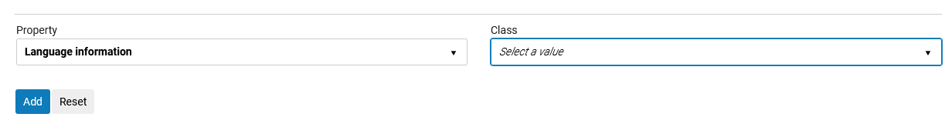
Adding a field to a BIBFRAME record - two live examples
After clicking “Add Field” the cataloger will
Choose the relevant Property (which in this case is “Language Information”)
If relevant choose the relevant Class (which in this case is not relevant)
Click “Add”
Add a field
Example two
“Class” is not relevant in this specific situation, so the field is being left blank

Slide 51
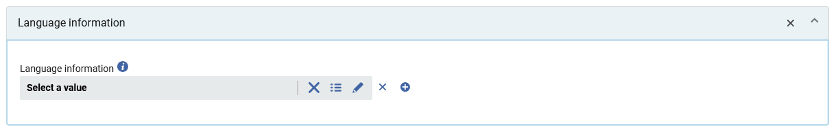
Adding a field to a BIBFRAME record - two live examples
The field is added with a blank value
Add a field
Example two

Slide 52
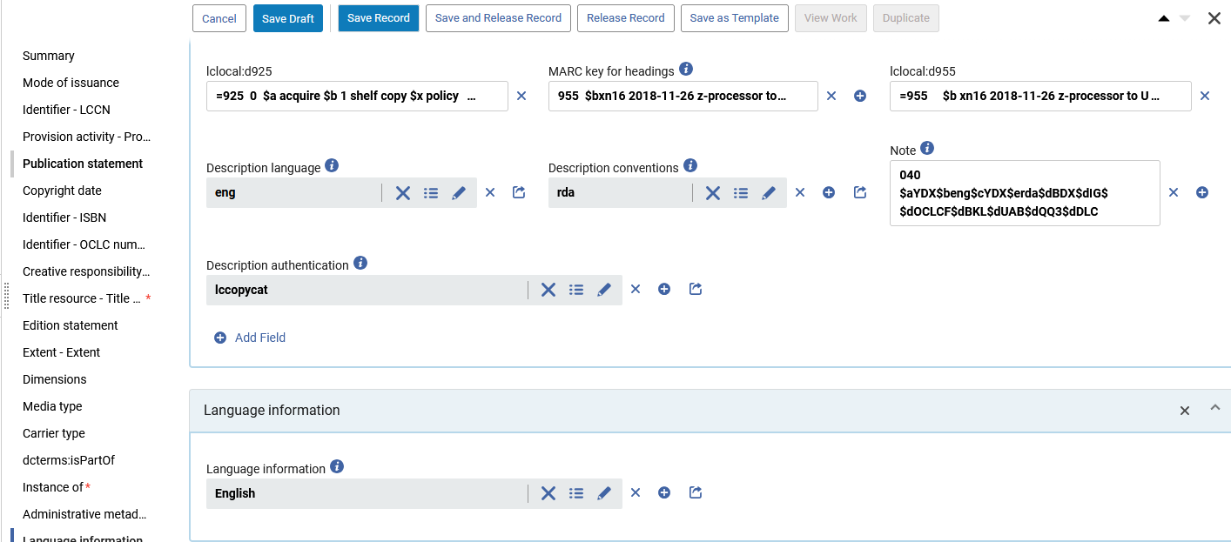
Adding a field to a BIBFRAME record - two live examples
The cataloger adds a value to the field and saves the record or draft
Add a field
Example two

Slide 53
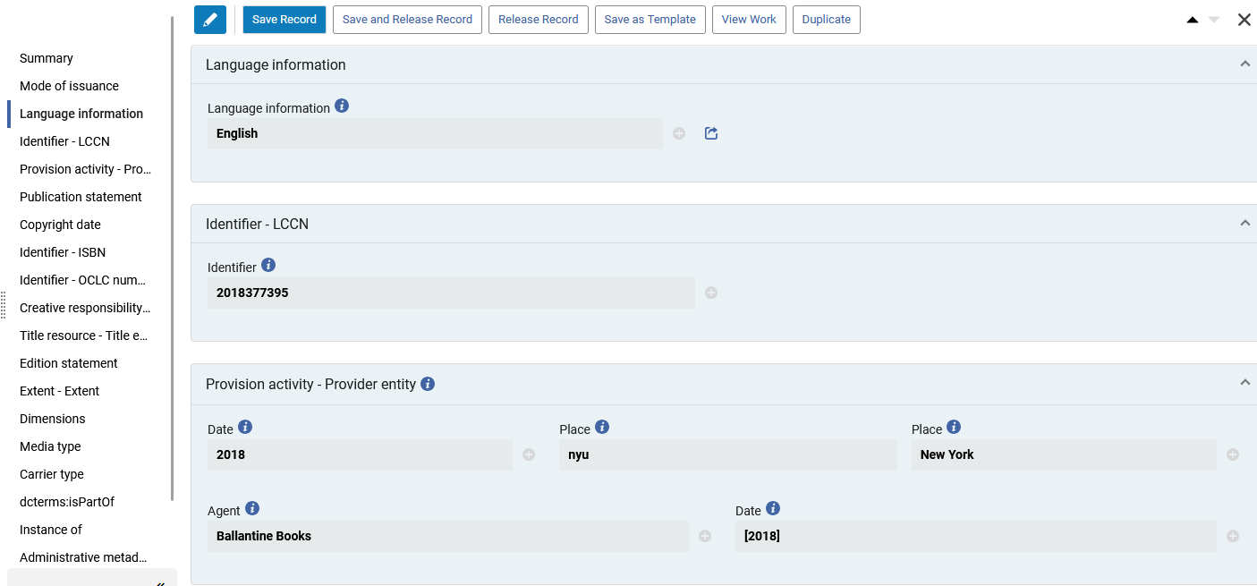
Adding a field to a BIBFRAME record - two live examples
The field is added and put into its own section in the corresponding location in the record
Add a field
Example two

Slide 54
Adding a section to a BIBFRAME record - two live examples

Slide 55
Adding a section to a BIBFRAME record - two live examples
The cataloger will now add section “Classification - LCC Classification” to BIBFRAME Work title “Feminists don't wear pink and other lies”.
Values will be added as follows:
Classification number = HQ1111
Classification item number = .F4653 2018
Assigner = United States, Library of Congress
Status = used by assigner
Add a section
Example one

Slide 56
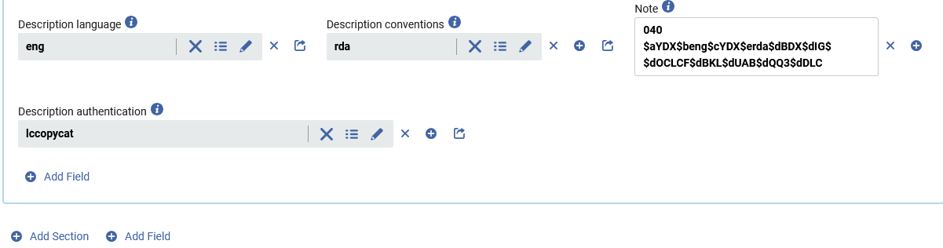
Adding a section to a BIBFRAME record - two live examples
The cataloger will scroll to the bottom of the editing draft and click “Add Section”
Add a section
Example one

Slide 57
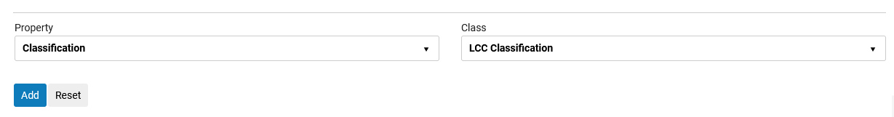
Adding a section to a BIBFRAME record - two live examples
The cataloger chooses the property and class of the section and clicks “Add”
Add a section
Example one

Slide 58
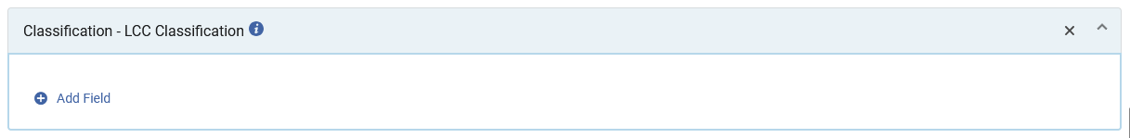
Adding a section to a BIBFRAME record - two live examples
Now the section has been added, and the cataloger will choose “Add Field” to add field(s) to the section
Add a section
Example one

Slide 59
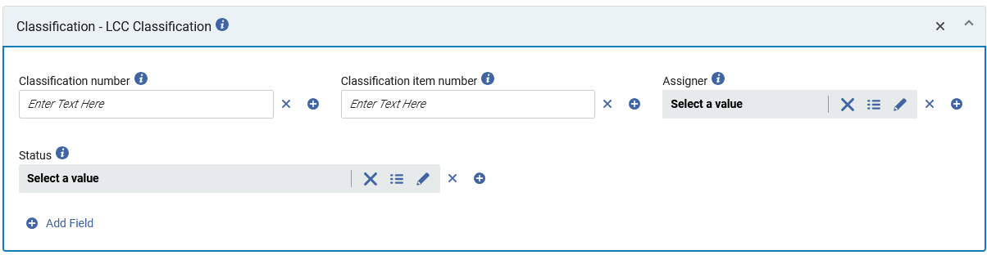
Adding a section to a BIBFRAME record - two live examples
All four fields have been added to the new section
Add a section
Example one

Slide 60
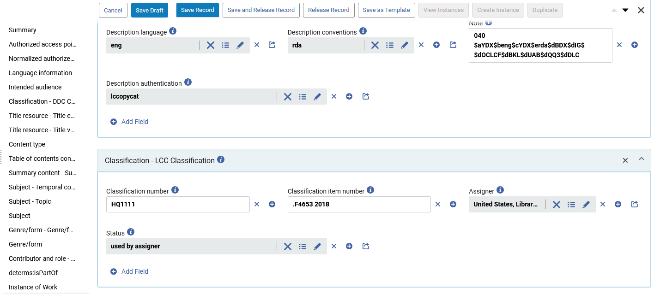
Adding a section to a BIBFRAME record - two live examples
The cataloger adds values to the fields in the section and saves the record or draft
Add a section
Example one
These fields all relate to each other and therefore they are added together into one section

Slide 61
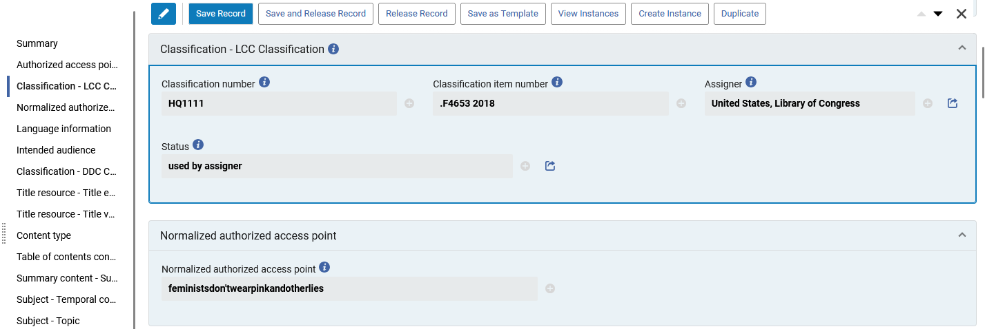
Adding a section to a BIBFRAME record - two live examples
The section is added and put into the corresponding location in the record
Add a section
Example one

Slide 62
Adding a section to a BIBFRAME record - two live examples
The cataloger will now add section “Contributor and role - Contribution” to BIBFRAME Work title “Feminists don't wear pink and other lies”.
Values will be added as follows:
Associated agent = Curtis, Scarlett
Contributor role = editor
Add a section
Example two

Slide 63
Adding a section to a BIBFRAME record - two live examples
The cataloger will scroll to the bottom of the editing draft and click “Add Section”
Add a section
Example two

Slide 64
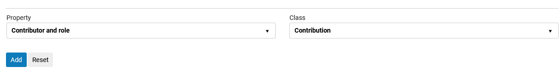
Adding a section to a BIBFRAME record - two live examples
The cataloger chooses the property and class of the section and clicks “Add”
Add a section
Example two

Slide 65
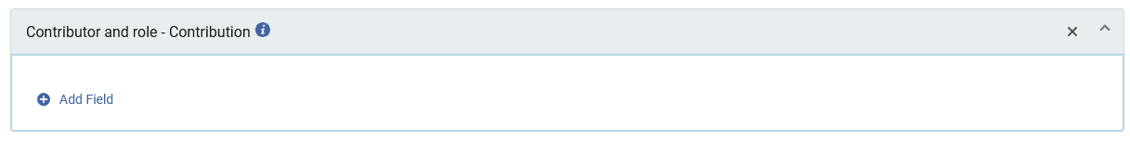
Adding a section to a BIBFRAME record - two live examples
Now the section has been added, and the cataloger will choose “Add Field” to add field(s) to the section
Add a section
Example two

Slide 66
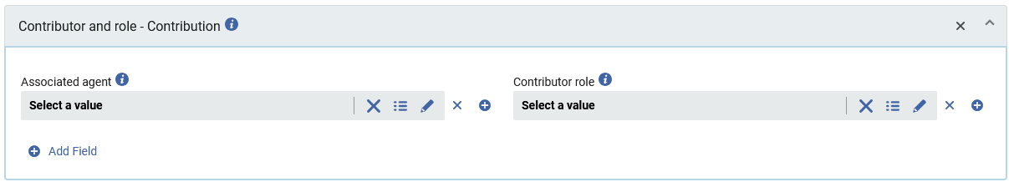
Adding a section to a BIBFRAME record - two live examples
Both fields have been added to the new section
Add a section
Example two

Slide 67
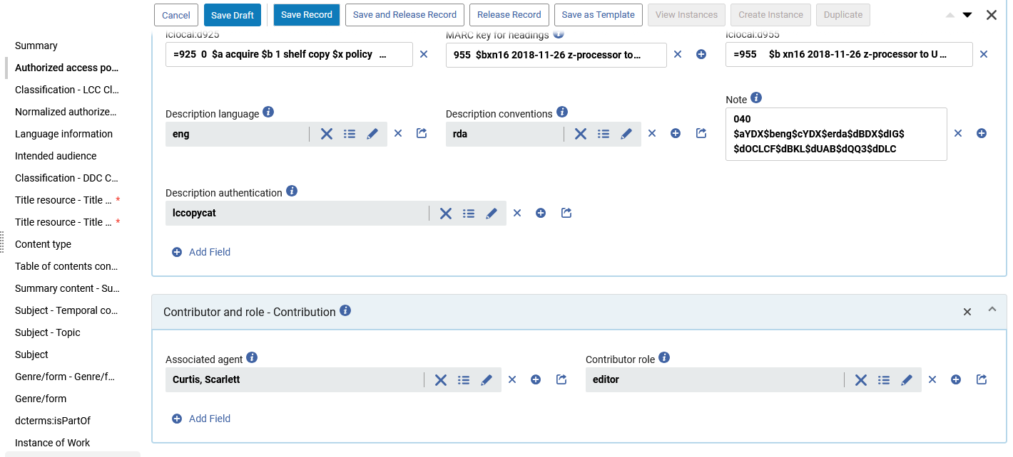
Adding a section to a BIBFRAME record - two live examples
The cataloger adds values to the fields in the section and saves the record or draft
Add a section
Example two
These fields all relate to each other and therefore they are added together into one section

Slide 68
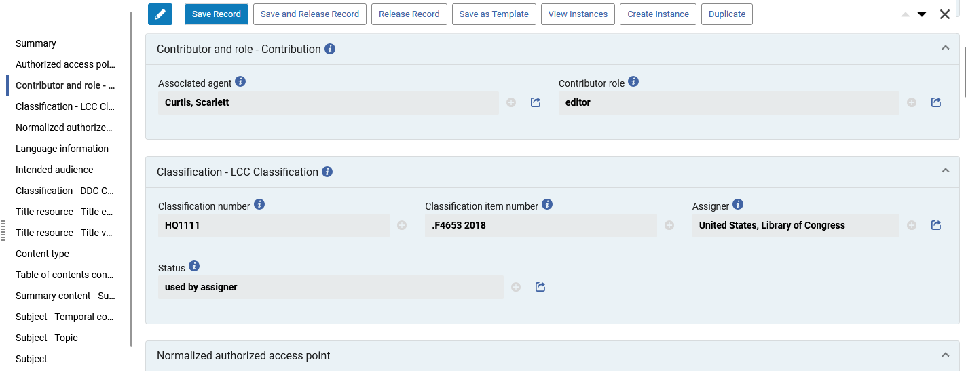
Adding a section to a BIBFRAME record - two live examples
The section is added and put into the corresponding location in the record
Add a section
Example one

Slide 69
Duplicating and removing fields

Slide 70
Duplicating and removing fields
For fields which are repeatable, there is a “plus” button next to the field in the linked open data editor for BIBFRAME.
This “plus” allows the cataloger to duplicate the field.

Slide 71
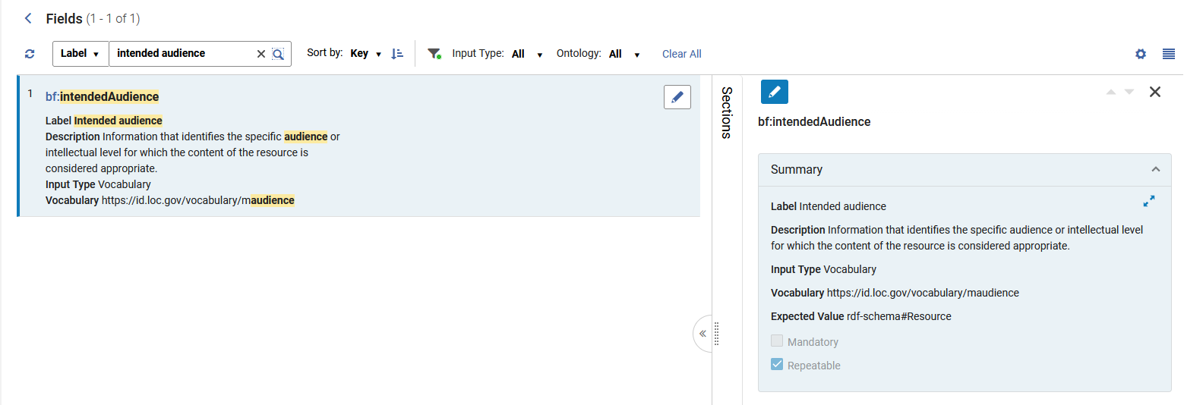
Duplicating and removing fields
For example, at “Configuration > Resources > Cataloging > Metadata Configuration > LC BIBFRAME Work” we see that the field “Intended Audience” is defined as repeatable

Slide 72
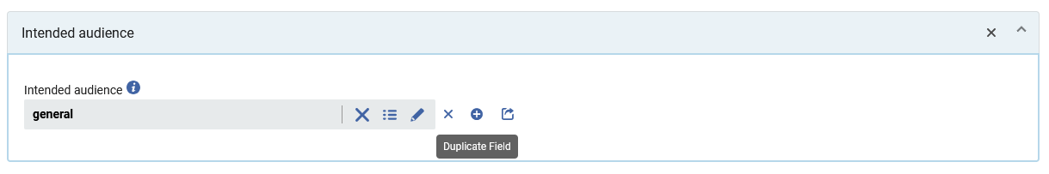
Duplicating and removing fields
Because “Intended audience” is a repeatable field, the cataloger has a “plus” button next to the field so that it can be duplicated.

Slide 73
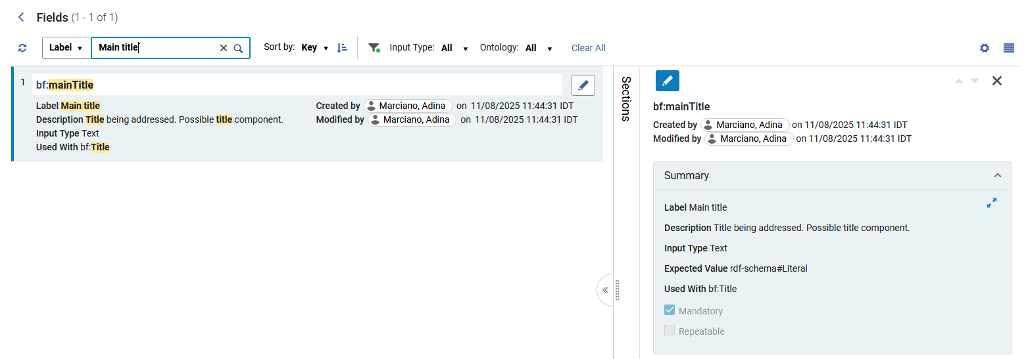
Duplicating and removing fields
For example, at “Configuration > Resources > Cataloging > Metadata Configuration > LC BIBFRAME Work” we see that the field “Main title” is not defined as repeatable

Slide 74
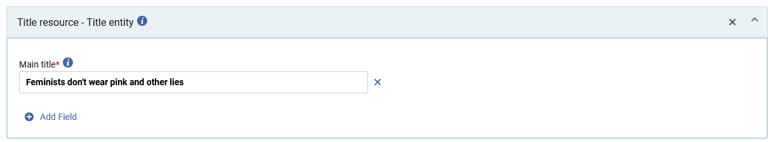
Duplicating and removing fields
Because “Main title” is not a repeatable field, the cataloger does not have a “plus” button next to the field so that it can be duplicated.
There is no “plus button” to duplicate the field

Slide 75
Duplicating and removing fields
Now the cataloger will duplicate the field “Intended audience”
While editing the Work with title “Feminists don't wear pink and other lies” the cataloger clicks the “plus” button next to the field “Intended audience” to duplicate the field.

Slide 76

Duplicating and removing fields
The field has been duplicated.
Now the cataloger will add a value to the field by clicking the Lookup icon (three lines)

Slide 77

Duplicating and removing fields
The cataloger found the desired value via the Lookup and adds it to the field

Slide 78


Duplicating and removing fields
The cataloger saves the Work with the duplicated field

Slide 79

Duplicating and removing fields
Fields can be removed by clicking the X button next to a field.
Clicking this X will remove the field “Intended audience” with value “adult”

Slide 80

Duplicating and removing fields
Section can be removed by clicking the X button in a section header.
Clicking this X will remove the section “Contributor and role – Contribution”

Slide 81
Duplicating and removing fields
The cataloger will now click the X button next to field “Intended audience” with value “adult”

Slide 82

Duplicating and removing fields
The cataloger will now confirm that he or she does in fact want to remove the field “Intended audience” with value “adult”

Slide 83

Duplicating and removing fields
The field “Intended audience” with value “adult” has been removed.
The field “Intended audience” with value “general” remains.
The Draft or Record may be saved.

Slide 84
Using the "Lookup" to enter a value in the field

Slide 85
Using the "Lookup" to enter a value in the field
The Linked Open Data Editor for BIBFRAME includes a Linked Data Lookup Service.
This provides catalogers with the ability to search for and connect entities from authoritative external sources without leaving the cataloging workflow.
This enables catalogers to:
Search for authoritative entities
View detailed metadata
Select and link entities to their records with confidence while cataloging

Slide 86
Using the "Lookup" to enter a value in the field
At the current time the Linked Data Lookup Service supports the following sources:
Library of Congress Authority Services:
LCSH (Library of Congress Subject Headings)
LCSH KIDS
LCFGT (Genre/Form Terms)
LC NAMES
Description Authentication Action
Cultural Heritage Organizations
Wikidata
LOC Controlled Vocabularies (as described in the Field Configuration)

Slide 87
Using the "Lookup" to enter a value in the field
It is possible to add values to fields
Via the Linked Data Lookup Service
By typing in the data manually.
When a field is designed to get data added via the Linked Data Lookup Service there are three lines to the right of the field, and clicking the three lines opens the Linked Data Lookup Service
When a field is designed to get data added manually there are not three lines to the right of the field, and data can be added manually by merely typing it into the field.

Slide 88

Using the "Lookup" to enter a value in the field
Media Type and Carrier Type are examples of fields that get data added via the Linked Data Lookup Service
Therefore, there are three lines to the right of the field, and clicking the three lines opens the Linked Data Lookup Service

Slide 89

Using the "Lookup" to enter a value in the field
Extent and Dimensions are examples of fields that get data added manually.
Therefore, there are not three lines to the right of the field, and data can be added manually by merely typing it into the field.

Slide 90

Using the "Lookup" to enter a value in the field
We will now use the Linked Data Lookup Service to add the following to the BIBFRAME Instance of title “Feminists don't wear pink and other lies”:
Media Type = unmediated
Carrier Type = volume
We click here to search for a specific “Media Type”

Slide 91

Using the "Lookup" to enter a value in the field
We search for the specific value and select it

Slide 92

Using the "Lookup" to enter a value in the field
The value is added

Slide 93
Using the "Lookup" to enter a value in the field
We will now use the Linked Data Lookup Service to add
Media Type = unmediated
Carrier Type = volume
We click here to search for a specific “Carrier Type”

Slide 94

Using the "Lookup" to enter a value in the field
We search for the specific value and select it

Slide 95

Using the "Lookup" to enter a value in the field
The value is added

Slide 96

Using the "Lookup" to enter a value in the field
We will now use the Linked Data Lookup Service to add the following to BIBFRAME Work title “Feminists don't wear pink and other lies”
Associated agent = Curtis, Scarlett
Contributor role = editor
We click here to search for a specific “Associated agent”

Slide 97

Using the "Lookup" to enter a value in the field
We can search a variety of external resources

Slide 98

Using the "Lookup" to enter a value in the field
We have searched LC Names, found the desired Associated agent, and selected it

Slide 99

Using the "Lookup" to enter a value in the field
The value is added

Slide 100
Using the "Lookup" to enter a value in the field
Now we will perform a Lookup on the “Contributor role”

Slide 101

Using the "Lookup" to enter a value in the field
We have searched, found the desired Contributor role, and selected it

Slide 102

Using the "Lookup" to enter a value in the field
The value is added

Slide 103

Using the "Lookup" to enter a value in the field
When we used the “Lookup” to add data to the fields, a URI was added to the record.
URI of the Associated agent
URI of Contributor role

Slide 104
Using the "Lookup" to enter a value in the field
The fact that these URIs were added to the record
http://id.loc.gov/authorities/names/no2018143381 for the Associated agent
http://id.loc.gov/vocabulary/relators/edt for the Contributor role
Is a major advantage of BIBFRAME over MARC
Rather than having strings such as “1001_ $$a Curtis, Scarlett $$e editor” in many records in many catalogs around the world, they all point to a URI (or URIs).
Rather than needing to change the string of the heading in each catalog (for example if the name changes or birth and death dates are added in subfield d) the change is made once in the URI.
All records already point to the URI so there is no need to make the change in the records.

Slide 105
Not using the "Lookup" to enter a value in the field

Slide 106
Not using the "Lookup" to enter a value in the field
We will now add data to a field without using the Linked Data Lookup Service .
We will add:
Extent = xi, 363 pages
Dimensions = 20 cm
We do not have anywhere to click to add from a “Lookup”.

Slide 107

Not using the "Lookup" to enter a value in the field
The cataloger adds values to the fields (without using a “Lookup”) and saves the record or draft

Slide 108

Not using the "Lookup" to enter a value in the field
The data is added

Slide 109
Obtaining information (help) about a specific field

Slide 110

Obtaining information (help) about a specific field
In the Linked Open Data Editor for BIBFRAME it is possible to obtain additional information about a field by hovering over the “More Information” icon.
While editing the work with title “Feminists don't wear pink and other lies”, the cataloger will now click the “More Information” icon for “Associated agent”

Slide 111

Obtaining information (help) about a specific field
The cataloger gets a detailed description of the field (in this case “Associated agent”) coming from the BIBFRAME documentation, as well as a link to the source
The cataloger will now click this link

Slide 112

Obtaining information (help) about a specific field
After clicking the link, the cataloger is brought to the official documentation for the field.

Slide 113

Obtaining information (help) about a specific field
Let’s see another example.
While editing the work with title “Feminists don't wear pink and other lies”, the cataloger will now click the “More Information” icon for “Intended audience”

Slide 114

Obtaining information (help) about a specific field
The cataloger gets a detailed description of the field (in this case “Intended audience”) coming from the BIBFRAME documentation, as well as a link to the source
The cataloger will now click this link

Slide 115

Obtaining information (help) about a specific field
After clicking the link, the cataloger is brought to the official documentation for the field.

Slide 116

Obtaining information (help) about a specific field
In cases where there is both a Property and a Class, two links will appear.
A link with first letter lowercase for a Property (there will always be a property)
A link with first letter uppercase for a Class
Staff user clicked here
Description
Link for the Property
Link for the Class

Slide 117

Obtaining information (help) about a specific field
Here is the link for the Property

Slide 118

Obtaining information (help) about a specific field
Here is the link for the Class

Slide 119


Yoel Kortick
Yoel.Kortick@clarivate.com
About Clarivate
Clarivate is a leading global provider of transformative intelligence. We offer enriched data, insights & analytics, workflow solutions and expert services in the areas of Academia & Government, Intellectual Property and Life Sciences & Healthcare. For more information, please visit clarivate.com.
© 2026 Clarivate. All rights reserved
Clarivate and its logo, as well as all other trademarks used herein are trademarks of their respective owners and used under license.

